Slide 1
Bank Marketing Campaign Analysis
Identifying the Key Drivers of Term Deposit Subscriptions and Opportunities to Improve Future Marketing Campaigns
Presented By
Aderogba Oluwapelumi Shadrack
AnalystLab Africa Internship
7th June, 2026

Slide 2
Business Problem
Banks invest significant resources in marketing campaigns to promote term deposit products, yet not all customers respond positively to these efforts.
This analysis seeks to answer:
Why do some customers subscribe while others do not?
Which customer segments are most likely to convert?
Which campaign strategies drive the highest success rates?
How can future marketing campaigns be improved?

Slide 3
Dataset Overview
Dataset Size
11,162 Customers
16 Variables
Customer Information:
Age
Job
Marital Status
Education
Financial Information:
Balance
Housing Loan
Personal Loan
Default Status
Campaign Information:
Contact Method
Duration
Campaign Contacts
Previous Contacts
Previous Outcome
Target Variable:
Deposit Subscription

Slide 4
Customer & Financial Profile Insights
Key Findings
Customers aged 65+ achieved the highest subscription rate (80.4%).
Students recorded the highest conversion rate among occupations (74.7%).
Customers with very high balances achieved a subscription rate of 57.5%.
Customers without housing loans subscribed significantly more frequently than customers with housing loans.

Slide 5
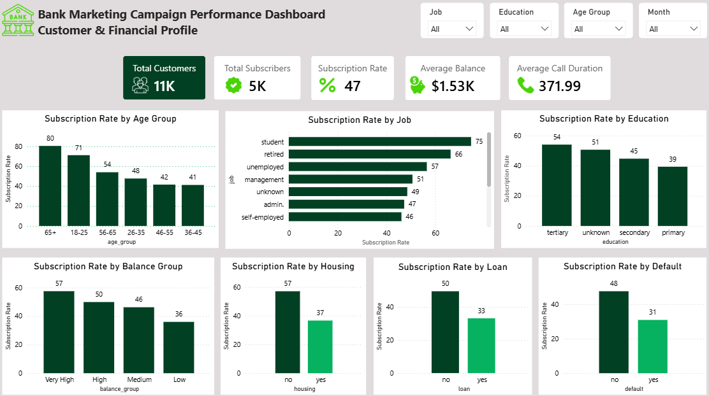
Customer & Financial Profile Dashboard

Slide 6
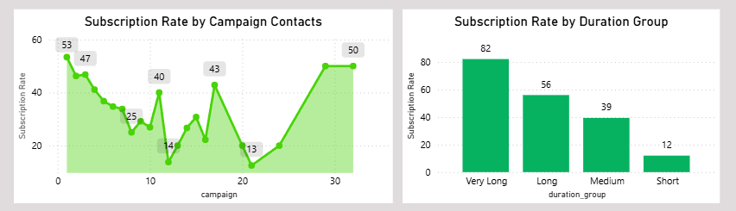
Campaign Effectiveness Insights
Key Findings
Customers contacted once achieved the highest reliable conversion rate (53.4%).
Conversion rates declined steadily as contact frequency increased.
Subscription rates increased from 12.0% for short calls to 82.2% for very long calls.

Slide 7
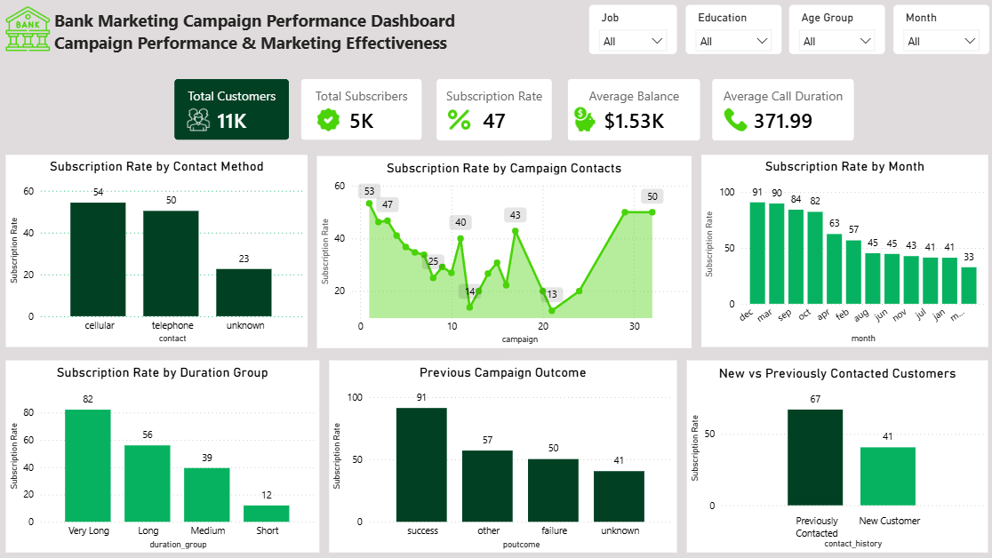
Campaign Effectiveness Dashboard

Slide 8
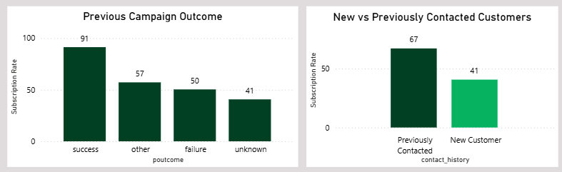
Previous Campaign Analysis
Key Findings
Customers with a successful previous campaign outcome achieved a 91.3% subscription rate.
Previously contacted customers converted at 67.1%, compared to 40.7% among new customers.

Slide 9
Key Business Insights
Previous campaign success is the strongest predictor of future subscription.
Longer customer conversations are strongly associated with higher conversion rates.
Repeated contact attempts generate diminishing returns.
Financially stable customers are more receptive to term deposit products.
Customer demographics influence campaign performance.
Campaign timing affects customer responsiveness.

Slide 10
Recommendations & Conclusion
Recommendations
Prioritize customers with positive campaign histories.
Focus on high-performing customer segments.
Improve the quality of early customer interactions.
Limit excessive contact attempts.
Target financially stable customers.
Strengthen agent training and engagement strategies.
Optimize campaign timing.
Conclusion
The analysis demonstrates that previous customer relationships, customer engagement during calls, financial stability, and campaign execution significantly influence subscription behavior. By focusing on these areas, the bank can improve marketing efficiency, increase conversion rates, and achieve better returns on future marketing investments.

